Slide 1

Analyzing Amazon Sales Data
This Photo by Unknown Author is licensed under CC BY

Slide 2
Introduction
Sales data is a term that includes a large array of metrics but, broadly speaking, if you can measure something in relation to the sales process, it’s viable sales data. Modern software like Cloud CRM solutions can help you collect this data, but it’s important to learn how to read this data to understand what it means for your business and where you can improve. With such an expansive sales data definition, it can be hard to know where to focus your efforts—especially if you also have to spend time selling. Sales analytics provide the ability to break sales down into comprehensible pieces and allow businesses to examine exactly what is working and what needs improvement. So for that we can use any tools and techniques as per the convenience like Python,Tableau etc.

Slide 3
Details of Data
Following details are available regarding the amazon sales :-
Region
Country
Item Type
Sales Channel
Order Priority
Order Date
Order ID
Ship Date
Units Price
Units Sold
Units Cost
Total Revenue
Total Profit
Total Cost

Slide 4
Main KPIs
Profit – Year wise, MonthYear wise, Region wise, Country wise, Items wise.
Revenue – Year wise, MonthYear wise.
Cost – MonthYear wise, cost of Items per Sales channels.

Slide 5
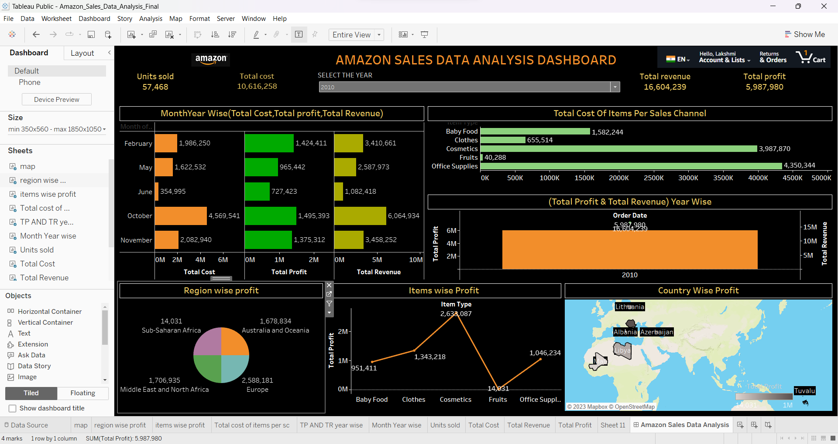
Mock – up Dashboard

Slide 6
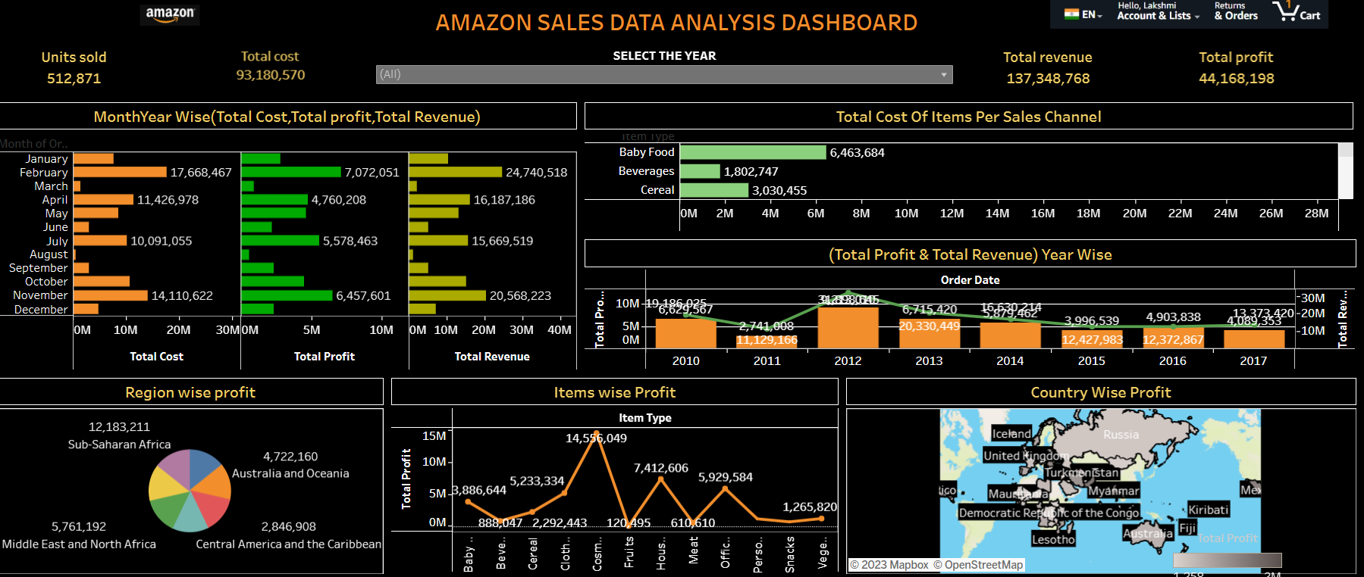
My Design

Slide 7
Thank you

